Slide 1

Joyish Animal Care Campaign Pitch Deck
Bringing Joy to Every Paw and Tail

Slide 2
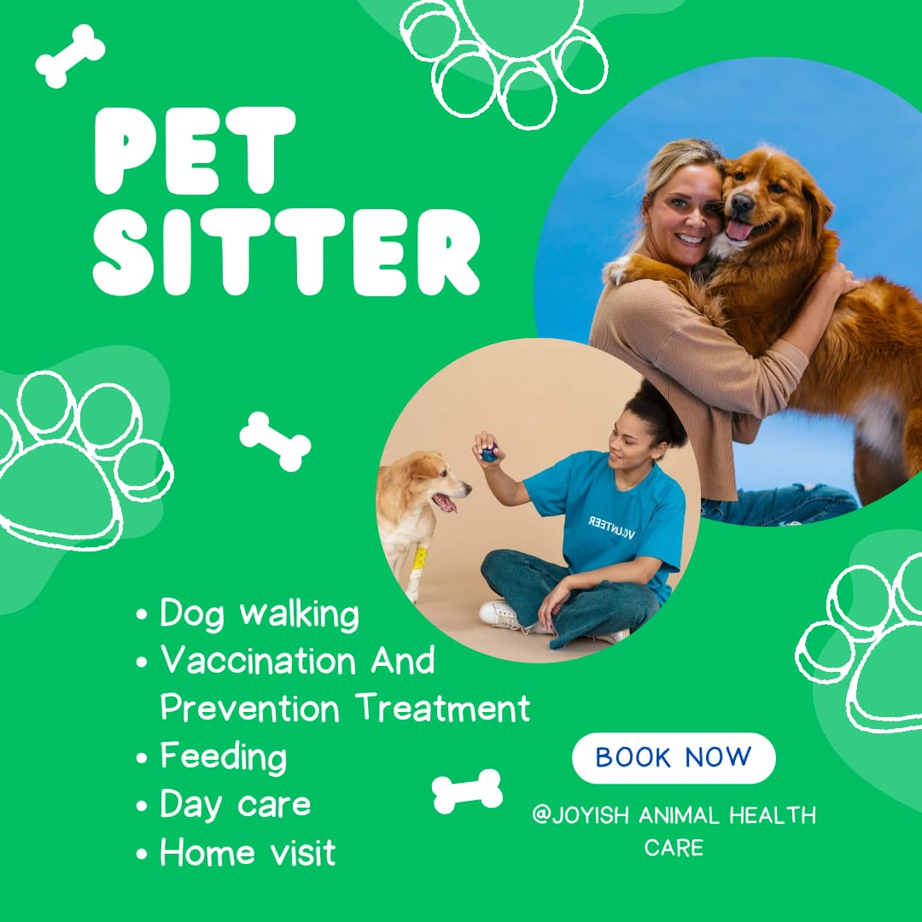
Brand Goal
Joyish Animal Care exists to provide joyful, loving, and expert care for pets.
Our goal is to become a trusted name in animal wellness, grooming and personalized care services.

Slide 3
Campaign Strategy Overview
Campaign Goal: Awareness & Conversion
Core Message: Bringing Joy to Every Paw and Tail
Funnel Breakdown:
Awareness: Pet tips, fun reels, and educational content
Consideration: Testimonials and behind-the-scenes care
Action: CTAs, discount posts, email sequences

Slide 4
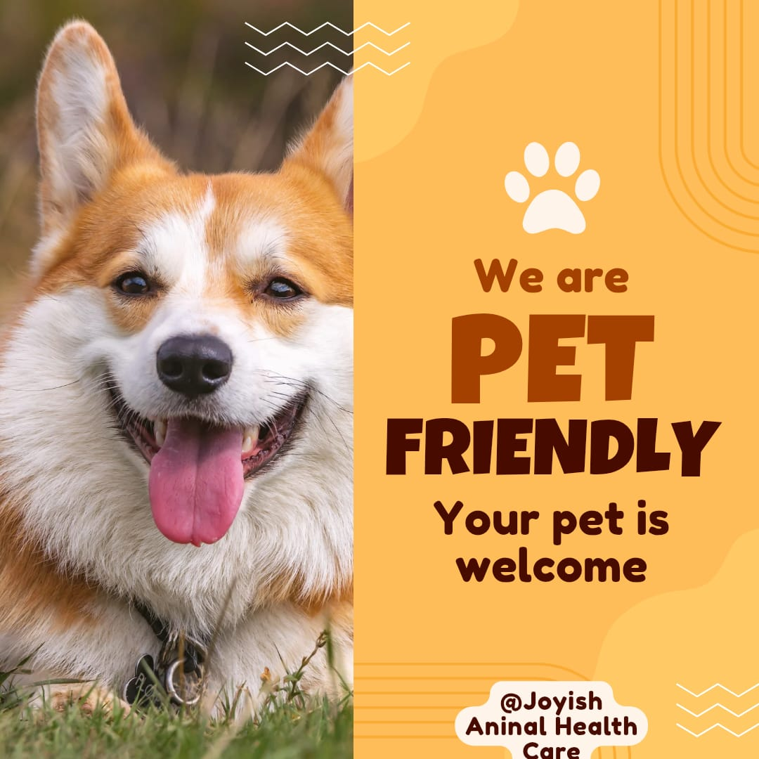
Content Headlines
Post 1: Meet Joyish – Intro Reel (Instagram Reels)
Post 2: Behind the Scenes of Pet Care (TikTok/Instagram)
Post 3: Pet Health Tips Carousel (Instagram/LinkedIn)
Post 4: Customer Testimonial (Facebook Carousel)
Post 5: 15% Discount Promo (Static + Email)

Slide 5
4 Weeks Campaign Timeline
Week 1 – Awareness
Intro Reels, Brand Story, Pet Fun Facts
Week 2 – Engagement
Polls, BTS Videos, Q&A
Week 3 – Consideration
Testimonials, Educational Tips
Week 4 – Conversion
Discount Offers, Booking CTA, Email Campaign

Slide 6

Expected Impact
Increase in brand awareness through social reach
Growth in email subscribers and leads
More bookings from discount and testimonial-driven trust
Higher engagement through polls and reels
Strong emotional connection with pet-loving audience

